Slide 1


Slide 2

مدیریت استراتژیک فناوری اطلاعات درخت تصمیم
تهیه و تنظیم:
رضا میرزاباقری

Slide 3
What is a Decision Tree?
An inductive learning task
Use particular facts to make more generalized conclusions
A predictive model based on a branching series of Boolean tests
These smaller Boolean tests are less complex than a one-stage classifier
Let’s look at a sample decision tree…

Slide 4
Predicting Commute Time
Leave At
If we leave at 10 AM and there are no cars stalled on the road, what will our commute time be?
10 AM
9 AM
8 AM
Stall?
Accident?
No
Yes
Long
No
Yes
Short
Long
Medium
Long

Slide 5
Inductive Learning
In this decision tree, we made a series of Boolean decisions and followed the corresponding branch
Did we leave at 10 AM?
Did a car stall on the road?
Is there an accident on the road?
By answering each of these yes/no questions, we then came to a conclusion on how long our commute might take

Slide 6
Decision Trees as Rules
We did not have represent this tree graphically
We could have represented as a set of rules. However, this may be much harder to read…

Slide 7
Decision Tree as a Rule Set
if hour == 8am
commute time = long
else if hour == 9am
if accident == yes
commute time = long
else
commute time = medium
else if hour == 10am
if stall == yes
commute time = long
else
commute time = short
Notice that all attributes do not have to be used in each path of the decision.
As we will see, all attributes may not even appear in the tree.

Slide 8
How to Create a Decision Tree
We first make a list of attributes that we can measure
These attributes (for now) must be separate
We then choose a target attribute that we want to predict
Then create an experience table that lists what we have seen in the past

Slide 9
Sample Experience Table
Example | Attributes |  |  |  | Target
 | Hour | Weather | Accident | Stall | Commute
D1 | 8 AM | Sunny | No | No | Long
D2 | 8 AM | Cloudy | No | Yes | Long
D3 | 10 AM | Sunny | No | No | Short
D4 | 9 AM | Rainy | Yes | No | Long
D5 | 9 AM | Sunny | Yes | Yes | Long
D6 | 10 AM | Sunny | No | No | Short
D7 | 10 AM | Cloudy | No | No | Short
D8 | 9 AM | Rainy | No | No | Medium
D9 | 9 AM | Sunny | Yes | No | Long
D10 | 10 AM | Cloudy | Yes | Yes | Long
D11 | 10 AM | Rainy | No | No | Short
D12 | 8 AM | Cloudy | Yes | No | Long
D13 | 9 AM | Sunny | No | No | Medium

Slide 10
Choosing Attributes
The previous experience decision table showed 4 attributes: hour, weather, accident and stall
But the decision tree only showed 3 attributes: hour, accident and stall
Why is that?

Slide 11
Choosing Attributes
Methods for selecting attributes (which will be described later) show that weather is not a discriminating attribute
We use the principle of Occam’s Razor: Given a number of competing hypotheses, the simplest one is preferable

Slide 12
Choosing Attributes
The basic structure of creating a decision tree is the same for most decision tree algorithms
The difference lies in how we select the attributes for the tree
We will focus on the ID3 algorithm developed by Ross Quinlan in 1975

Slide 13
Decision Tree Algorithms
The basic idea behind any decision tree algorithm is as follows:
Choose the best attribute(s) to split the remaining instances and make that attribute a decision node
Repeat this process for recursively for each child
Stop when:
All the instances have the same target attribute value
There are no more attributes
There are no more instances

Slide 14
Identifying the Best Attributes
Refer back to our original decision tree
Leave At
10 AM
9 AM
8 AM
Stall?
Accident?
Long
No
Yes
No
Yes
Short
Long
Medium
Long
How did we know to split on leave at and then on stall and accident and not weather?

Slide 15
ID3 Heuristic
To determine the best attribute, we look at the ID3 heuristic
ID3 splits attributes based on their entropy.
Entropy is the measure of disinformation…

Slide 16
Entropy
Entropy is minimized when all values of the target attribute are the same.
If we know that commute time will always be short, then entropy = 0
Entropy is maximized when there is an equal chance of all values for the target attribute (i.e. the result is random)
If commute time = short in 3 instances, medium in 3 instances and long in 3 instances, entropy is maximized

Slide 17
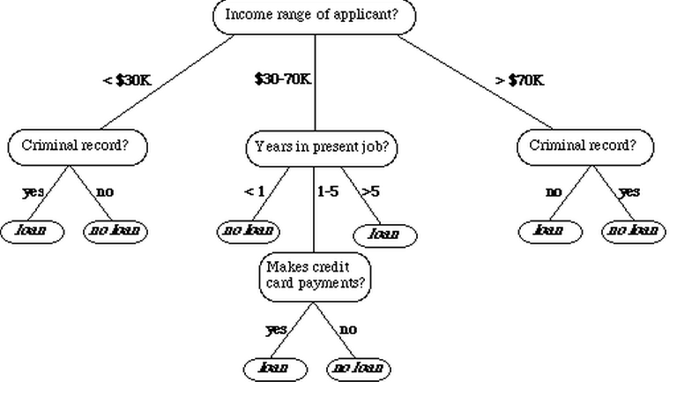

Slide 18
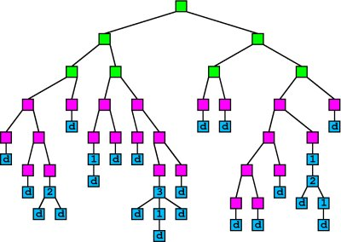

Slide 19
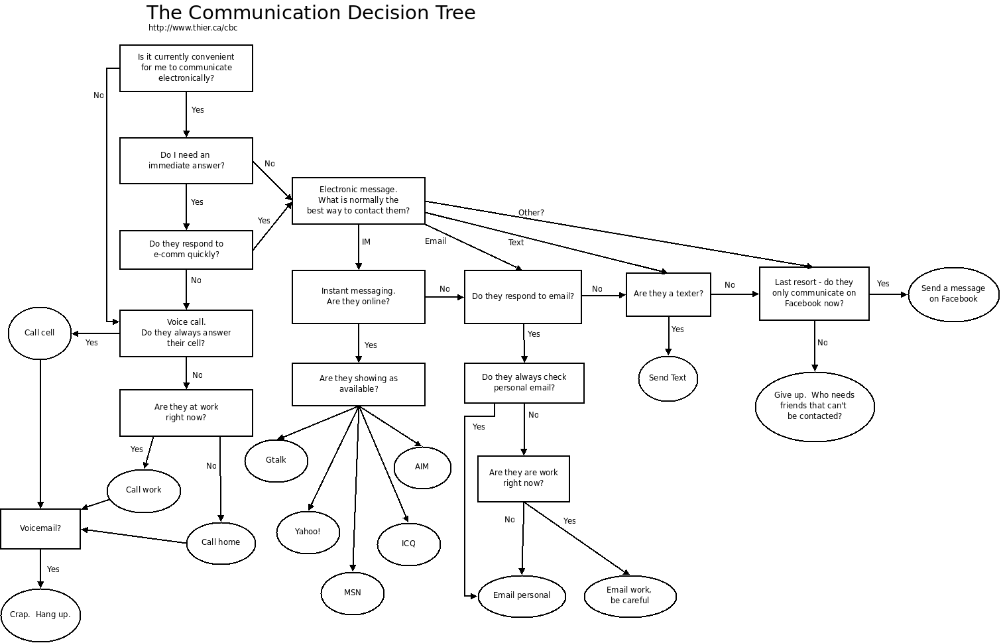

Slide 20


